Slide 1

Conference presentation

Slide 3

Agenda
Meet the presenter
Background
Breakout questions
Hypothesis
Making great products
Comparing Contoso to the competition
History
Key takeaways
Tips for businesses
Call to action

Slide 4
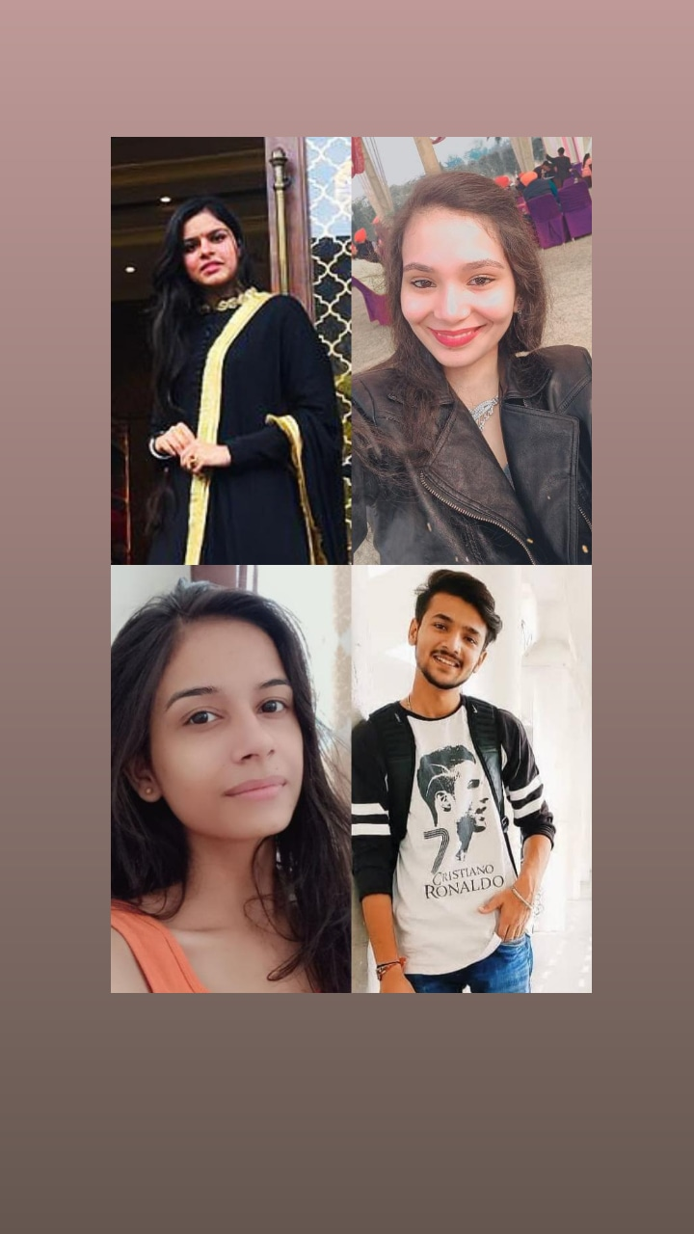

Meet The Developers
SHELLY (1900262)
SHRISHTI ARORA (1900266)
SHUBAM KUMAR (1900267)
SNEHDEEP KAUR (1900274)
BACK

Slide 5


Background
As a high school student, Mirjam’s interest in American Sign Language sparked her desire to study communication, which led to her focus on technology and how it enhances communication.

Slide 6
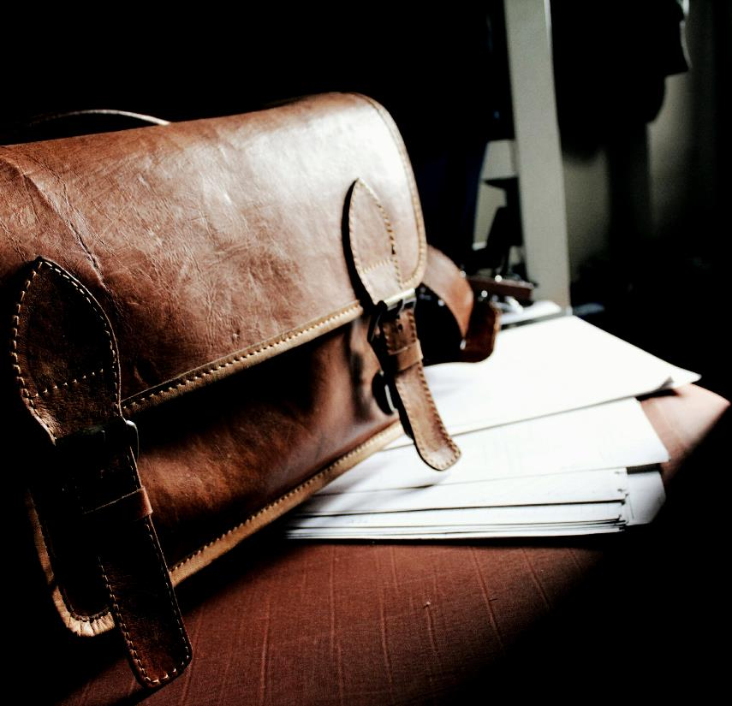
Login Options
Employee
No.
1
No.
HR
2
No.
HR Head
3

Slide 7

“If you can film an idea in your mind, follow that film idea shot for shot, scene for scene, that idea is worth making.
CRAIG MAPP

Slide 8
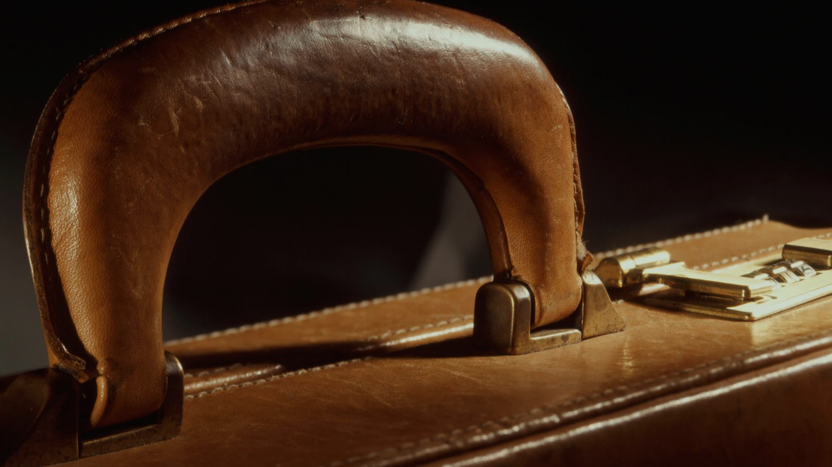
HR Login
UserId
Password
SUBMIT
BACK

Slide 9
ISSUE MY COMPLAINT

Slide 10
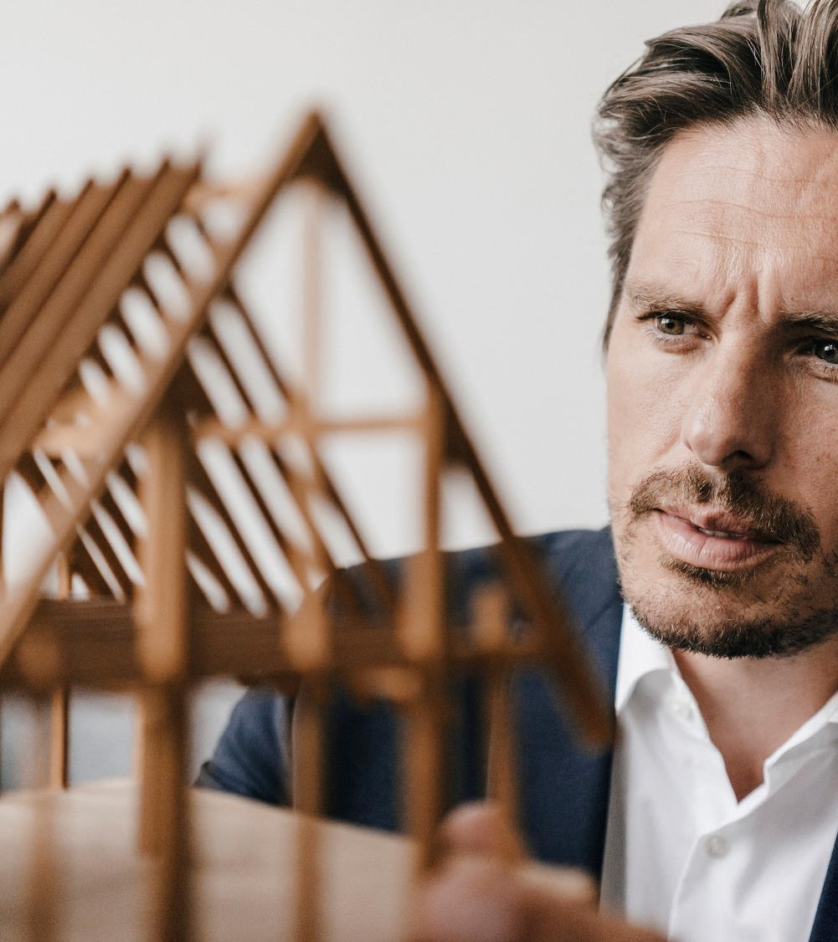
Making great products
Take risks to lead in product innovation
Listen to customers and learn what they need
Test with customers until you get the product right

Slide 11


ARTIFICIAL Scienes
AGENDA
DEVELOPERS
LOGIN

Slide 12
HR Dashboard
VIEW
PROFILE
CHANGE PASSWORD
VIEW COMPLAINTS
LOGOUT

Slide 13


Delete User
Select Kind Of Employee
Enter ID
DELETE
BACK

Slide 14

Tips for businesses
No.
1
Take risks to lead in product innovation
No.
2
Listen to customers and learn what they need
No.
3
Test with customers until you get the product right

Slide 15
ISSUE
STATUS
BACK

Slide 16
Complaint Id
Status
Issue
Complaint Lodge Date
Response Date
BACK

Slide 17

Complaint ID
Last Action Performed
Complaint Lodge Date
Current Status
SET STATUS
ISSUE
RESPOND
BACK

Slide 19

ADD DETAILS
Employee Name
Email
KIND OF EMPLOYEE
Contact
Department No
ADD
BACK

